Slide 1
Tier II
^{REVISIONS CLARIFIED}

Slide 2
Notes:
A little bit about FTCH

Slide 3

Agenda
Tier II
  Implementation
  Resources
  Enforcement

Slide 4
Implementation

Slide 5
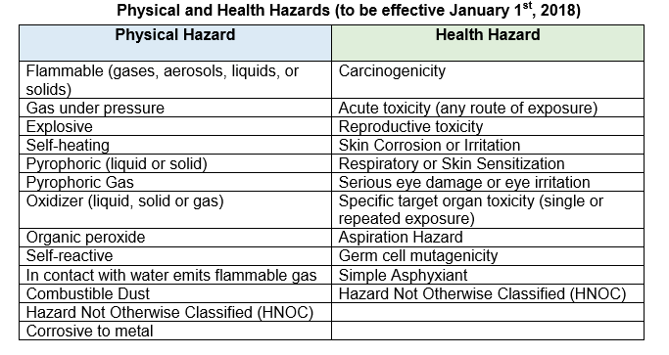
Understand the Hazard Categories
Notes:
Use HNOC under Physical Hazards for Non-Hazardous Materials such as oils and coolants

Slide 6
Get Current Versions of Safety Data Sheets (SDS’)
If SDS meets GHS requirements, then should be easy data transcription; no interpretation required
SDS are not always updated, although required by law back in 2015
Notes:
It is manufacturers responsibility to determine the OSHA hazards and provide on SDS

Slide 7
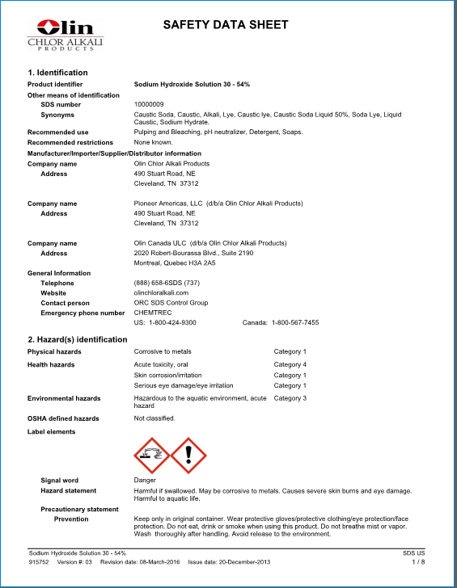
“Good” Example of SDS
Notes:
Easy transcription to Tier II

Slide 8
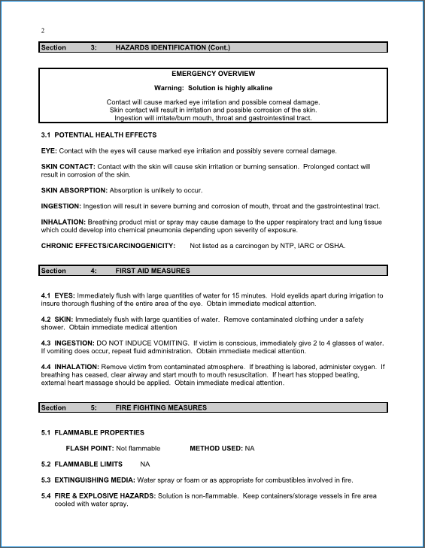
“Bad” Example of old MSDS
Notes:
MSDS requires interpretation

Slide 9
RESOURCES

Slide 10
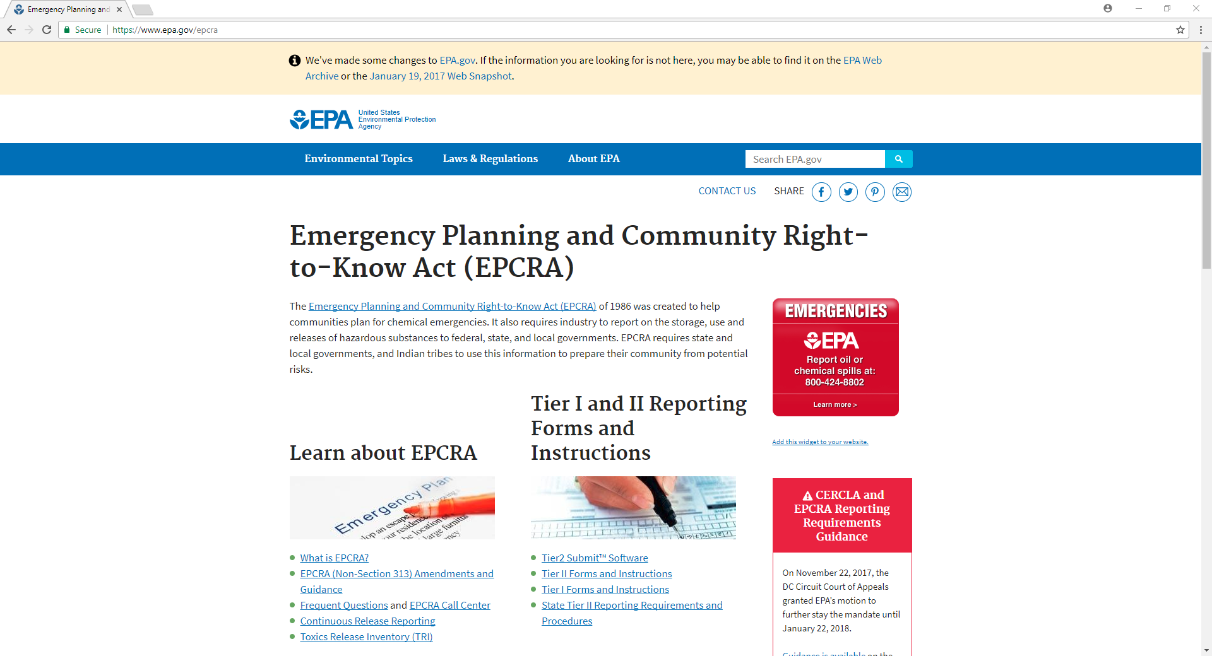
EPA EPCRA Website
Notes:
Tier II Instructions include what chemicals are excluded: food, drug or cosmetic regulated by FDA; solids without exposure under normal use; same form as used by general public; substance used in research labs/hospitals/medical; routine ag operations or fertilizer held for sale by retailer to ultimate customer

Slide 11
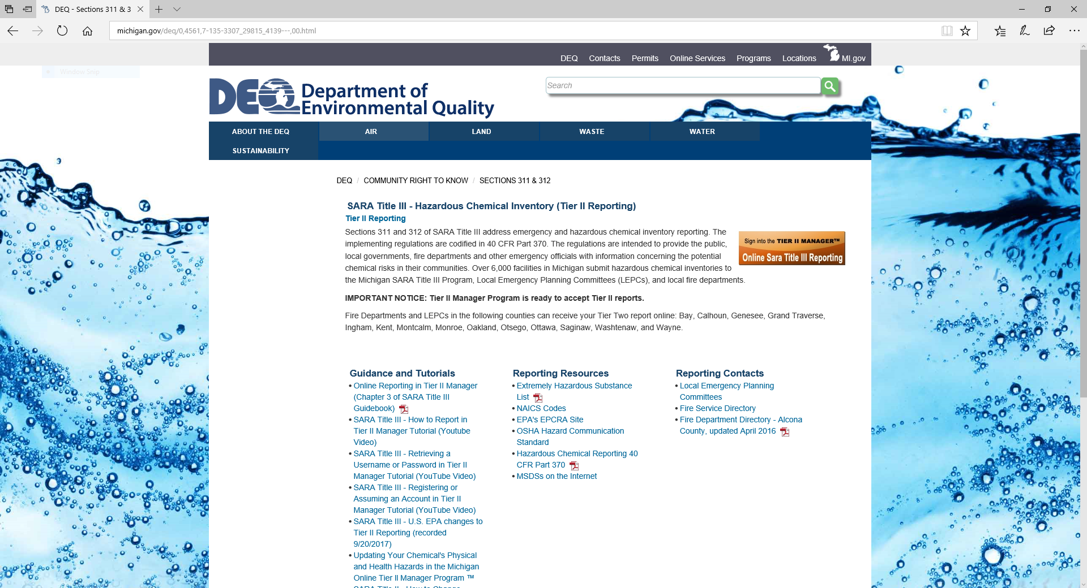
MDEQ EPCRA Website
Notes:
YouTube videos are helpful. Also list of LEPCs and MDEQ SARA Guidebook

Slide 12
Other
EPA List of Lists: https://www.epa.gov/sites/production/files/2015-03/documents/list_of_lists.pdf
OSHA GSH Guide: https://www.osha.gov/dsg/hazcom/ghsguideoct05.pdf
Free SDS database: www.chemicalsafety.com/sds-search
Chemical Suppliers
Consultants

Slide 13
ENFORCEMENT

Slide 14

EPCRA Increase in Daily Max Civil Penalty
$37,500 $54,789
  (per day, per violation)

Slide 15
Common Tier II Mistakes
Considering lead acid batteries as exempt articles like TRI
Forgetting about EHS’ with lower thresholds such as ammonia and sulfuric acid
Forgetting about diesel ASTs (not at retail gas stations)
Remembering that anything with a SDS (and physical and/or health hazard) needs to be considered

Slide 16
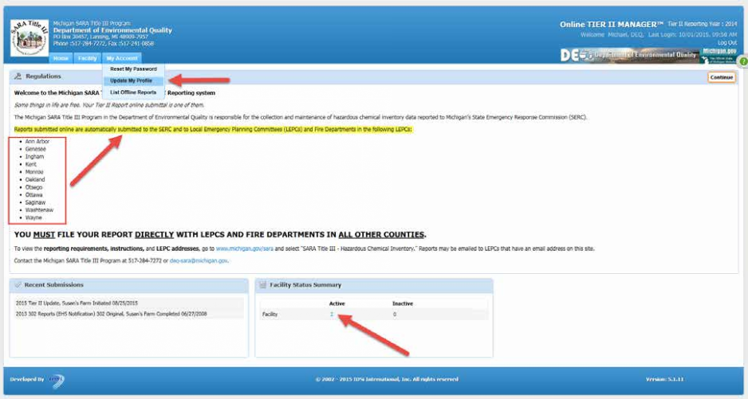
Not Reporting to LEPC
Notes:
Tell story of FTCH’s confidential client who submitted using Tier II online but did not submit hard copy to their LEPC. Not all LEPCs pay for a license for Michigan’s Tier II Manager.

Slide 17

Lead Acid Battery EPA Notice of Violation & Fine
Light Manufacturing/Warehouse Client in Grand Rapids Area
Notes:
Tell story of Liz’s confidential client. Received advanced notice from EPA Region V Tier II inspection. Found out inspector was nearby for a conference. Company already was scheduled to do internal compliance audit of the facility as part of their on-going program. Company changed date of planned internal audit to be BEFORE inspector came. Discovered lead acid batteries were previously reported (only Tier II item reported) but due to staff changes had not been done in recent year and should have been. EPA inspector found same thing. EPA issued NOV with initial fine of $115,500. Company negotiated down to $37,500. In the meantime, company also audited other facilities and then surveyed all facilities and found multiple facilities who should be reporting batteries and never have. Company did audit self-disclosure to EPA Region IV and never heard anything. Statute of limitations has now passed.

Slide 18

Multi-Program EPA Settlement, with EPCRA Self-Disclosures
Tuna Processor in American Samoa
Notes:
Tell story of Tuna Processor’s Settlement (dated 12/22/17). Project was initially CWA violations (including wastewater exceedances, storm water discharges without a permit, and SPCC issues). Led to EPA general duty clause inspection under Section 112(r) CAA for ammonia, butane, and chlorine. Self-disclosure under EPA’s audit policy for CAA NESHAP, used oil, and community notification requirements of EPCRA. Ultimately $6.5 million civil penalty (US will receive $3.9 million and Territory of American Samoa will receive $2.6 million). Plus supplemental environmental project (SEP) for the purchase and donation of emergency response equipment to local responders in American Samoa at a cost of $88,000.

Slide 19
www.ftch.com

